Slide 1

Collider Liquid
Venture returns meets hedge fund liquidity

Slide 2
Legal Disclaimers
This introductory presentation has been prepared to provide prospective investors with the opportunity to determine their preliminary interest in receiving more information on Collider Ventures III, L.P. (the "Fund") and does not constitute an offer to sell, or a solicitation of an offer to buy, interest in the Fund, or any product or service, and is for informational purposes only and may not be used or relied upon in evaluating the merits of investing in the Fund. An offering of interests in the Fund will be made only by means of a limited partnership agreement and subscription documents (the "Fund Documents") and in such jurisdictions where permitted by (and in compliance with) law.
The information contained herein is unverified and prospective investors should take appropriate measures to verify the same. The information herein is qualified in its entirety by the Fund Documents the no offering of interests in the Fund may be made by any literature, advertising, or document in whatever form other than the Fund Documents, which may qualify, and materially differ from, the information and opinions contained herein. Moreover this introductory presentation does not purport to contain all of the information that may be required to evaluate an investment in the Fund. The Fund Documents contain important information regarding the Fund's investment objectives, risks, fees, and other matters of interest and should be carefully read prior to any investment in the Fund. There are no assurances that the stated investment objectives or targeted returns of the Fund will be met. An investor could lose all or substantially all of his or her investment.
The purchase of interests of the Fund is suitable only for sophisticated investors for whom an investment in the Fund does not constitute a complete investment program and who fully understand and are willing to assume the risks involved in the Fund's investment program. The interests described herein will not be registered under the laws of any jurisdiction including the Israeli Securities Law of 1968 and the United States Securities Act of 1933 or the United States Investment Company Act of 1940 (the “Acts”), the laws of any state of the United States or the laws of any other jurisdiction and may not be offered or sold without compliance to applicable securities laws. Investors in the Fund will not benefit from the rules and regulations made under the Acts for the protection of investors. This document is confidential and may not be reproduced or disclosed, distributed without the prior written consent of the general partner of the Fund. This presentation is intended for the person or entity to which it has been delivered.
You should not construe the contents of this presentation or any prior or subsequent communications from the Fund, its principals and their respective affiliates or any of their respective officers, members, employees, representatives or agents as legal, tax, regulatory, accounting or investment advice. You should conduct your own analysis with respect to legal and tax issues related to the Fund, together with your professional advisors. In particular, you should inform yourself as to the legal requirements and tax consequences within the country of your citizenship, residence, domicile and place of business with respect to the acquisition, holding and disposal of an Interest, and any foreign exchange or other restrictions that may be relevant thereto.
Insofar as any statements made in this presentation involve matters of opinion, assumptions, projections, anticipated events or estimates, whether or not expressly stated, they are set forth as such and not as representations of fact, no representation is made as to their accuracy or that all appropriate assumptions relating thereto have been considered or stated and actual results may differ substantially from those set forth, projected, forecast or estimated herein. No warranty or representation is given with respect to information contained in this presentation, or any income or expense of an asset, or the future projected financial performance.
The information contained herein is current only as of the date hereof (unless otherwise specifically mentioned in the presentation) and you should not, under any circumstances, assume that there has not been any change in the matters discussed herein since the date hereof. The Fund does not intend to update the contents of this presentation.
This presentation has not been filed, lodged, registered, reviewed or approved by any regulatory authority in any jurisdiction. The distribution of this presentation in certain jurisdictions may be restricted by law. Recipients of this presentation should inform themselves about, and observe any applicable legal or regulatory requirements in relation to, the distribution or possession of this presentation. Recipients of this presentation represent that they are qualified to receive this presentation in all relevant jurisdictions for them.
This presentation has not been registered as a prospectus with the Monetary Authority of Singapore. Accordingly, this presentation and any other document or material in connection with the offer or sale, or invitation for subscription or purchase, of the shares or units in Collider (the “Units”) may not be circulated or distributed, nor may the Units be offered or sold, or be made the subject of an invitation for subscription or purchase, whether directly or indirectly, to persons in Singapore other than: to an institutional investor (as defined in the SFA) pursuant to Section 274 of the Securities and Futures Act, Chapter 289 of Singapore (the “SFA”) or, as the case may be, Section 276(2)(a) of the SFA; to an accredited investor (as defined in the SFA) pursuant to Section 275(1) of the SFA, or as the case may be, Section 276(2)(b) of the SFA, and in accordance with the conditions specified in Section 275 of the SFA, and in accordance with the conditions specified in Regulation 3 of the Securities and Futures (Classes of Investors) Regulations 2018;
to a relevant person (as defined in Section 275(2) of the SFA) pursuant to Section 275(1) of the SFA, or any person pursuant to Section 275(1A) of the SFA, or, as the case may be, Section 276(2) of the SFA and in accordance with the conditions specified in Section 275, of the SFA, where each such person is an expert investor (as defined in the SFA) or not an individual.
Any reference to the SFA is a reference to the Securities and Futures Act, Chapter 289 of Singapore and a reference to any term as defined in the SFA or any provision in the SFA is a reference to that term as modified or amended from time to time including by such of its subsidiary legislation as may be applicable at the relevant time.
Acceptance of this presentation constitutes the recipient’s agreement to be bound by the terms of this Disclaimer.

Slide 3



Digital Assets have matured
Regulatory clarity, institutional participation, and US admin adoption are transforming the ecosystem
Out of this maturity emerges a new class of revenue generating businesses with massive growth and value accrual creation potential.
Collider Liquid Venture:
Captures asymmetries in onchain markets and crypto protocols.
Runs two fully liquid symbiotic strategies
Has no multi year lockups or no trapped capital.

Slide 4
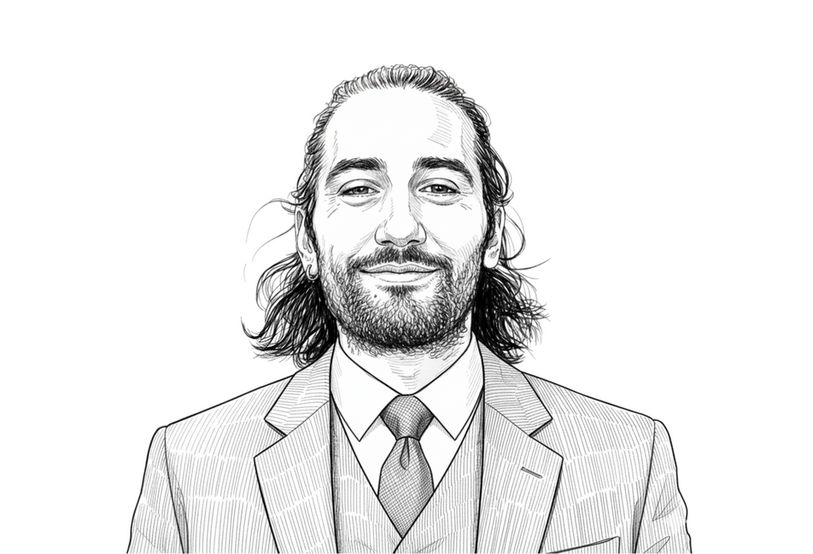
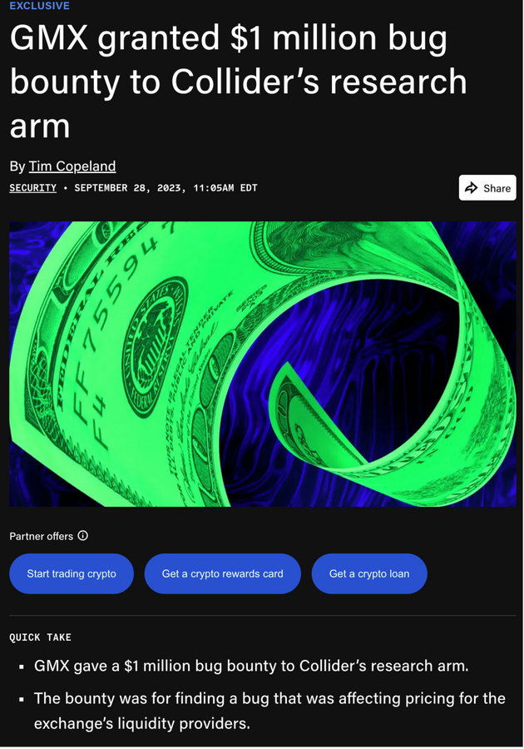
Why us?
Collider Liquid Venture grew organically out of Collider’s research team and Nostro management.
Risk at heart. From a $1M reward for discovering critical vulnerability in GMX to a disciplined, data driven approach where every position begins with pre-defined exit strategy scenarios.
Unique, privileged access through trust and relationships with the most influential people in the ecosystem. This ‘soft intel’ is crucial for identifying and timing both opportunistic plays and fundamental value opportunities.
Infrastructure and research frameworks that generate real time onchain intelligence, monitoring, and deep protocol evaluation metrics (risk, tokenomics, and revenue) from years of experience.
Adiel Yaakov - Fund manager & Partner
Exclusive Article

Slide 5

The Opportunity
A wedge between blind spots:
Index funds that own indiscriminately
Crypto VCs locked into illiquid allocations
Traditional managers can’t navigate crypto data and tokenomics.
The opportunities exist within this gap, where conviction driven analysis meets liquid execution.
We identified two symbiotic strategies.
Emerging crypto blue chips that generate real and substantial cash flows
Explosive momentum driven trades that last for hours - days.
As crypto matures, traditional finance will adapt and close this gap

Slide 6
Complementary Strategies
CORE POSITIONS
70-80% allocation
OPPORTUNISTIC OVERLAY
20-30% allocation
Holding Period:
Holding Period:
Medium-term (months), with flexibility based on market conditions and opportunity evolution
Short-term (days), with flexibility based on market conditions and opportunity evolution
Concentrated holdings in established protocols with proven revenue models and meaningful token value accrual.
We evaluate beyond surface level metrics: a protocol generating millions in revenue means nothing if token holders see no benefit.
We analyze the complete value flow: revenue generation, token buyback mechanisms, insider selling pressure, and actual net value accrual to holders. This requires deep, nuanced analysis that goes far beyond traditional financial metrics.
Narrative-driven momentum plays sourced through extensive crypto-native networks and real-time market intelligence.
Rapid deployment targeting the "meat of the move"—not perfect entries/exits, but capturing substantial upside during peak momentum phases.
Profits systematically funneled back to strengthen core positions.

Slide 7
Speculation evolves to real business fundamentals
Crypto has graduated from pure speculation to real businesses generating billions in revenue
Ann. Rev. ($M) | Market Cap ($M) | Revenue → Token Holders (% / $) | ~P/E | Name of Protocol
2,472 | 43,039 | 97% / 2,397 | ~17.4 | Hyperliquid
1,689 | 5,072 | 100% / 1,689 | ~3 | Pump
703 | 2,983 | 50% / 351.5 | ~4.25 | Jupiter
137 | 1,580 | 100% / 137 | ~11.5 | Sky
These businesses not only generate hundreds of millions in annualized revenue they allocate a significant portion of it to buying back their token, aligning the business’ success with stakeholders.
* Revenue figures were annualized from the last 30d revenue figures, as of September, 2025

Slide 8
You cant do this alone ...
Real-Time Defense, Zero Downtime
We’re the Ones People Call “Exit Liquidity”
Execution Is a Competitive Moat
24/7 monitoring, automated alerts, and kill switch execution
Smart contracts, multisigs, and custody audited and hardened
Exploits or drain attempts detected and acted on in minutes, not hours
Capital protected by infrastructure, not luck
Early access to information, teams, and private rounds
We track insider wallets, exchange flows, and onchain signals before they trend
When Twitter’s talking, we’re already exiting
Multi Execution layer for slippage control and smart routing
OTC and MM relationships let us size into positions quietly
Access to liquidity directly from teams.
Precision in entry and exit compounds returns

Slide 9
... We are here for you
Volatility Is Opportunity, Not Risk
We Trade on Information, Not Sentiment
Scale Works for Us, Not Against Us
Frameworks built for both trend and mean reversion environments
Hedging and derivatives used systematically, not emotionally
No panic, no diamond hands, just math
Real time onchain analytics for insider activity and whale movement
Governance tracking and tokenomics alerts before price impact
Years of proprietary feeds and networks that cut through noise
Capital allocation frameworks sized by risk, not gut feeling
Portfolio construction designed for convexity, not linear exposure
Catastrophic losses are engineered out by design
Small edges, repeated at scale, compound fast

Slide 10
Why Investors Fail at Liquid Crypto: Summary
This isn't stocks. Crypto moves fast and trades 24/7.
The information advantage of professionals vs. retail is insurmountable.
You're competing against teams with decade long networks, real time monitoring, and institutional execution. You are the counterparty they want to see. You will get rinsed.

Slide 11
Collider LV: Our Objective
Generate venture scale returns through liquid crypto markets.
Capture explosive upside potential without multi-year lockups
Enable LPs to see investments mature and realize returns while maintaining full flexibility to rebalance and adapt positions.

Slide 12





Our Edge:
The network
We’ve honed and built a vast, high fidelity information network across the entire crypto trading landscape | We’ve honed and built a vast, high fidelity information network across the entire crypto trading landscape | We’ve honed and built a vast, high fidelity information network across the entire crypto trading landscape | We’ve honed and built a vast, high fidelity information network across the entire crypto trading landscape
From other liquid fund managers, to whales and HWNIs, to market makers and OTC desks, to the most influential KOLs and “anon” traders | From other liquid fund managers, to whales and HWNIs, to market makers and OTC desks, to the most influential KOLs and “anon” traders | From other liquid fund managers, to whales and HWNIs, to market makers and OTC desks, to the most influential KOLs and “anon” traders | From other liquid fund managers, to whales and HWNIs, to market makers and OTC desks, to the most influential KOLs and “anon” traders
We catch events, news, narrative shifts and even calamities as soon or even before they happen | We catch events, news, narrative shifts and even calamities as soon or even before they happen | We catch events, news, narrative shifts and even calamities as soon or even before they happen | We catch events, news, narrative shifts and even calamities as soon or even before they happen
We are five partners, each with our own rabbit hole deeply immersed in different corners of crypto. | We are five partners, each with our own rabbit hole deeply immersed in different corners of crypto. | We are five partners, each with our own rabbit hole deeply immersed in different corners of crypto. | We are five partners, each with our own rabbit hole deeply immersed in different corners of crypto.
Together, we cover the full spectrum of the ecosystem, complementing one another and amplifying collective intelligence. | Together, we cover the full spectrum of the ecosystem, complementing one another and amplifying collective intelligence. | Together, we cover the full spectrum of the ecosystem, complementing one another and amplifying collective intelligence. | Together, we cover the full spectrum of the ecosystem, complementing one another and amplifying collective intelligence.
A thousand ears to a thousand grounds:

Slide 13




Our Edge: Information
Asymmetry
New launches are riddled with information asymmetry | New launches are riddled with information asymmetry | New launches are riddled with information asymmetry | New launches are riddled with information asymmetry
Metas quickly form and dissipate around shifting narratives | Metas quickly form and dissipate around shifting narratives | Metas quickly form and dissipate around shifting narratives | Metas quickly form and dissipate around shifting narratives
Governance forums, where integral business decisions are being made, are often criminally overlooked | Governance forums, where integral business decisions are being made, are often criminally overlooked | Governance forums, where integral business decisions are being made, are often criminally overlooked | Governance forums, where integral business decisions are being made, are often criminally overlooked
Onchain flows tell the story in real-time, before it reaches social media | Onchain flows tell the story in real-time, before it reaches social media | Onchain flows tell the story in real-time, before it reaches social media | Onchain flows tell the story in real-time, before it reaches social media
Explosive, highly volatile momentum trades offer extreme risk reward scenarios

Slide 14
Our Edge: Dynamic Risk Management
Constant monitoring: flows, volume, open interest, wallet tracking, tokenomics, governance
Constant, near real time re underwriting based on evolving information and trading flows
Front running narrative formation and selling into strength
Maintaining high information advantage through unique and extensive PM / trader / whale networks cultivated over years
Position sizing calibrated to risk/reward within portfolio context
Derivative hedging and sophisticated execution through OTC relationships

Slide 15
Adiel Yaakov
A seasoned crypto veteran with a decade of liquid crypto market experience.
Before joining Collider, Adiel worked as a lead analyst for various crypto companies, developing his data-driven, fundamental approach to market analysis. Adiel joined Collider in 2021 as Head of Research before running the firm's DeFi liquid fund for three years with exceptional returns.
Throughout Adiel’s crypto career, he has successfully captured multiple 100-1000x opportunities while maintaining rigorous due diligence standards, demonstrated when he uncovered a critical GMX vulnerability, earning a $1.1M bounty for responsible disclosure.
As a partner in Collider's venture team, Adiel manages the funds’ investments as well as the firm's liquid nostro generating triple-digit returns, serves as a recognized master of incentive design and tokenomics for portfolio companies, and maintains extensive relationships with the most influential people across the crypto ecosystem—from high-profile builders to market makers, fund managers, and influential market participants—ensuring access to high-quality intelligence crucial for identifying and timing both opportunistic plays and fundamental value opportunities. Adiel’s academic background is in neuroscience (magna cum laude).
Adiel Yaakov
Fund manager & Partner

Slide 16
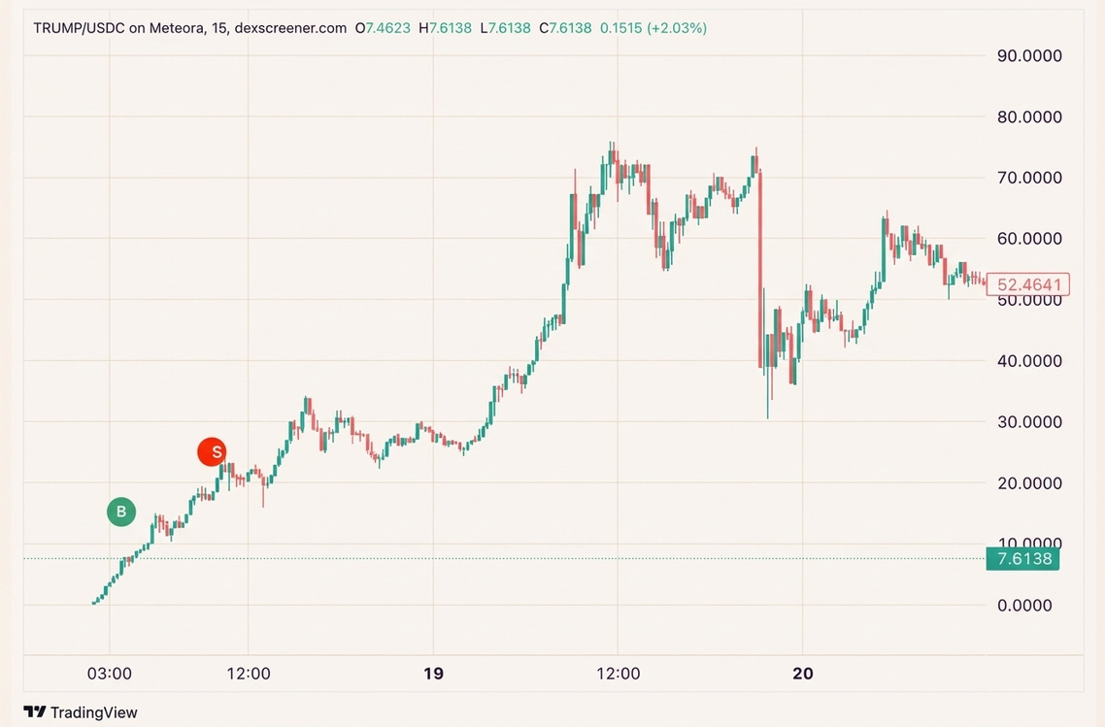
Trade Example B: Opportunistic / Event Based ($TRUMP)
We took a sizeable position very early on in $TRUMP. We sold it a day later for more than 10x.
POTUS launched his own memecoin. It was very risky to long in size as there was no official confirmation, just rumors.
We had minutes to conduct thorough and meticulous research. We found out the $TRUMP token website used the same Cloudflare servers as his Trumpcard NFTs website.
That gave us the edge to long way ahead of the official Trump family public confirmation.

Slide 17
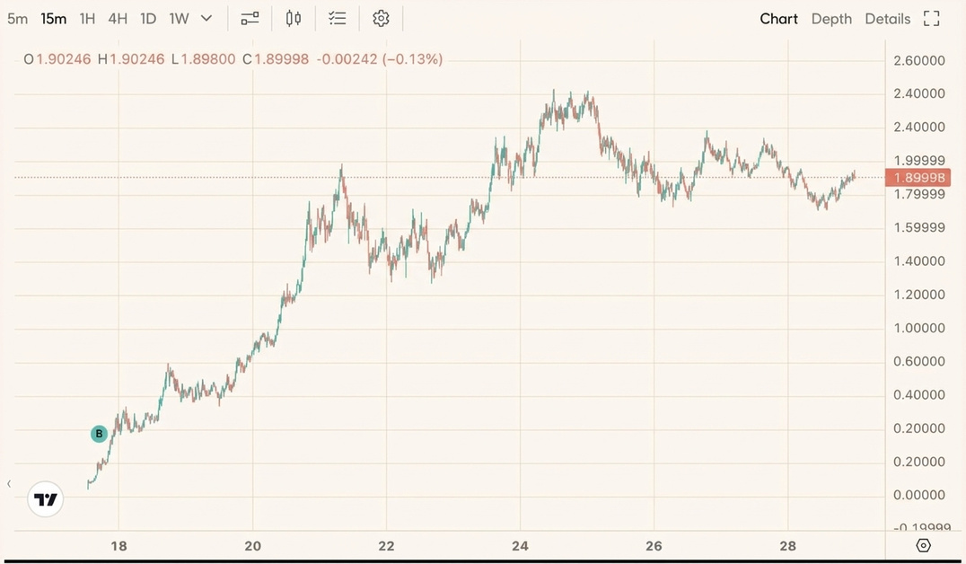
Trade Example B: Opportunistic / Momentum Based ($ASTER)
Our $ASTER entry: $0.156
Noticed increase flows into BSC.
Cross-referenced with other astute liquid fund managers.
Cross-referenced with tastemaker ‘anon’ influencers & traders.
Confirmed the real-time formation of the “Binance’s bet on a Hyperliquid competitor” narrative
Verified the ongoing ‘FUD’ around withdrawal hiccups amidst social media and Discord is not a risk.
Sized-in as we realized: “This is about to be big, and everyone is sidelined.”

Slide 18
Trade Example A: Fundamentally driven ($PUMP)
Result: Generated ~250% unrealized returns by in 8 weeks identifying fundamental value before market recognition
Contrarian Conviction
Due Diligence Edge
Market consensus: "Just another meme launchpad", “team’s trying to extract maximum value”, “this goes to $0”
Our thesis: Category-defining revenue machine generating $700M+ in 16 months outearning most other protocol
Deep tokenomics analysis: 97% revenue → direct buybacks
P/E analysis: $4B FDV vs $78M monthly revenue = compelling valuation that also drives forward a narrative
Identified structural supply squeeze at TGE with minimal sell pressure by design
Execution Advantage
Risk Management
Secured allocation in oversubscribed private sale through network relationships
Close collaboration with founding team provided early visibility into token structure and vesting schedules
Probability weighted key risks (regulatory, competitive, demand overhang, market sentiment, narrative)
Sized position according to asymmetric risk/reward within portfolio context
Entry at $4B FDV vs comparables trading at 8-15x higher valuations

